Slide 1
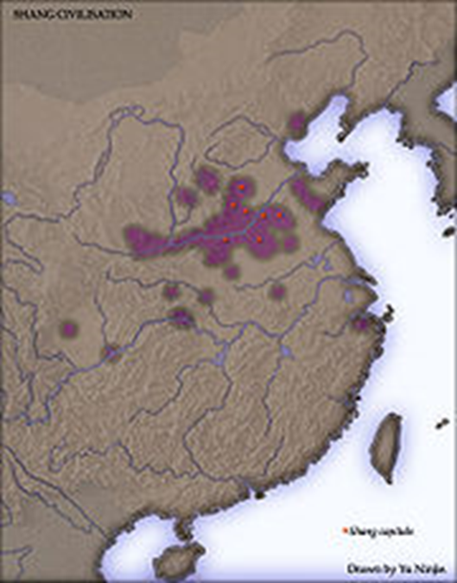
Yellow River Valley
Settled agriculture began around 8000 B.C.E. and was widespread by 6000 B.C.E.
Emergence of communities around 2600 B.C.E.
Divided into “regional cultures”
Longshan culture rose in eastern China around 2600 B.C.E.

Slide 2
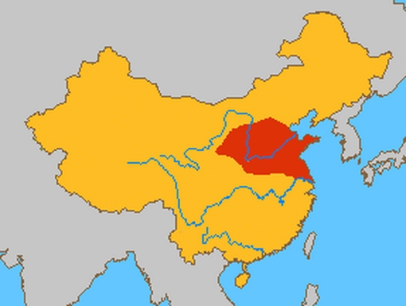
Xia Dynasty
2070 – 1600 B.C.E.
Established in the Shandong region by Yu the Great in 2070 B.C.E.
An agrarian culture with bone and stone tools
1st organized bureaucratic government
1st government to follow dynastic policy making it the 1st dynasty

Slide 3
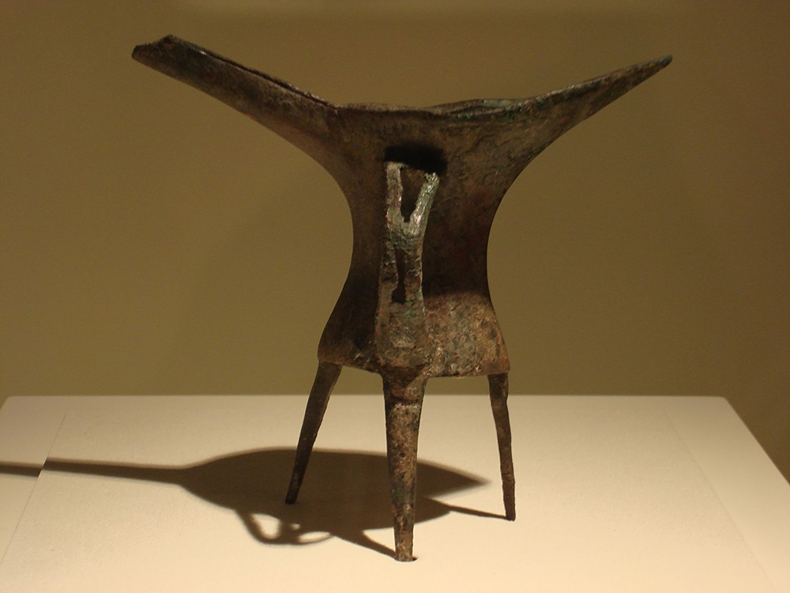
Xia Dynasty
Instituted new laws and customs
Developed the production of silk
Advancements in agriculture, such as canals and irrigation
Advancements in medicine
Advancements in technologies, such as casting bronze and a calendar

Slide 4
Xia Dynasty
Developed bronze armor for warfare
Maintained a strong army
Bronze craftworks were decorated with Jade
Established a regional trade network
Developed a calendar system based on the movements of the moon and sun
Made numerous attempts to control the flooding of the Yellow River

Slide 5
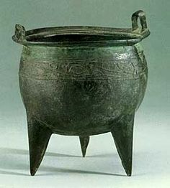
Decline of the Xia Dynasty
A series of weak rulers, along with internal and external conflicts, led to breakaway vassal states
Poor harvest and flooding led to widespread discontent
The death of King Jie in 1675 B.C.E. marked the end of the Xia Dynasty
Xia were overthrown by the Shang state

Slide 6
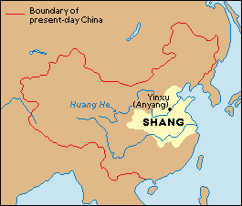
Shang Dynasty
1675 – 1050 B.C.E
Established by Tang of the Shang tribe following the overthrow of the Xia Dynasty
Gained control over the Xia lands
Urban centers begin to be established around 1350 B.C.E.
Introduced writing, metalworking and social classes
Believed in many gods, including a supreme “Deity Above”

Slide 7
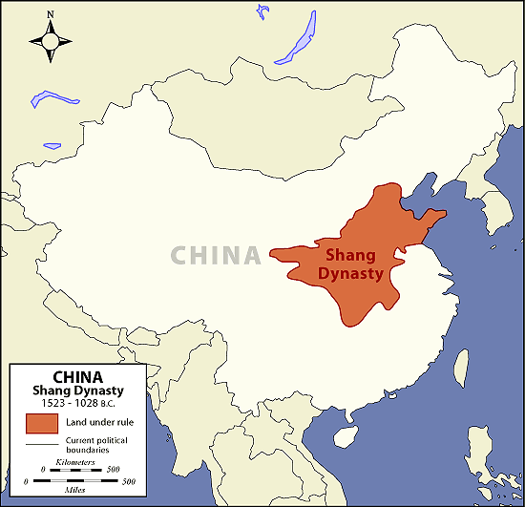
Shang Dynasty
Created a 360 day calendar for planting and harvest seasons
Ruler’s political power was based on land ownership and a concept known as “Mandate of Heaven”
King appointed local governors
Rulers supported public works projects and new agricultural technologies

Slide 8
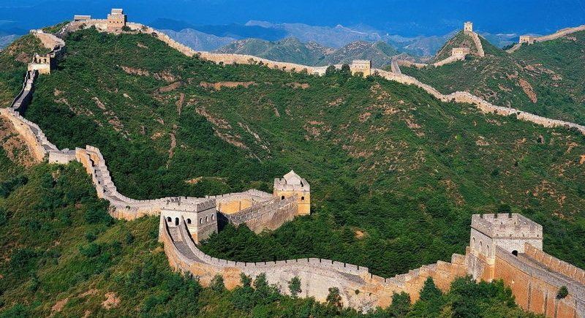
Shang Dynasty
Introduced a written language with nearly 6000 characters
Expanding agricultural production allowed for population increase
Population increase allowed for more peasants to be used as labor on projects, such as the Great Wall

Slide 9
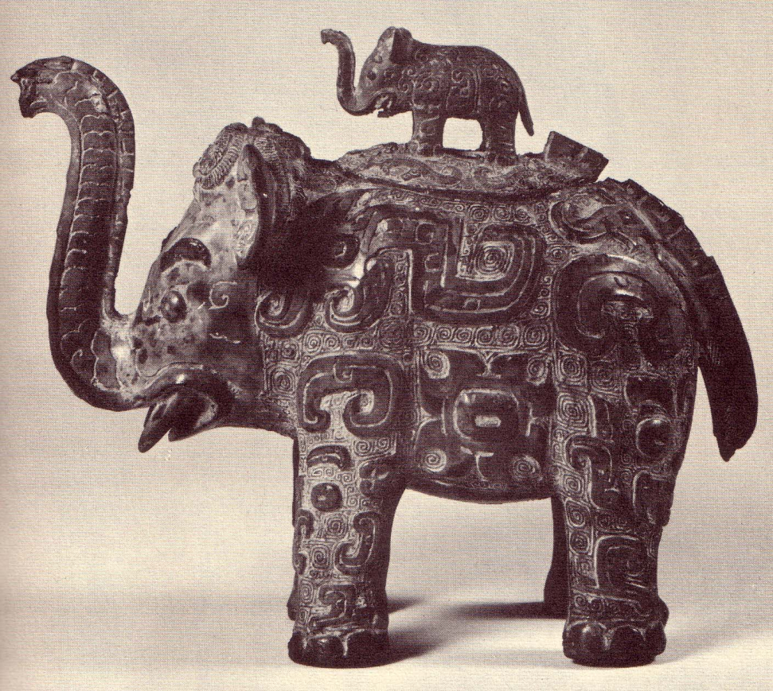
Decline of the Shang Dynasty
By 1300 B.C.E. regional trade growth allowed for states to breakaway
Warfare and a series of weak and self indulgent rulers led to decline around 1200 B.C.E.
Shang rulers lost the mandate of heaven

Slide 10
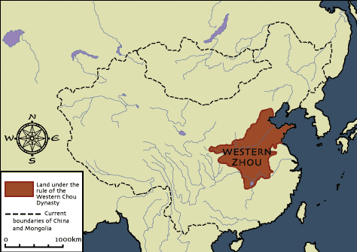
Zhou Dynasty
1046 – 256 B.C.E.
Filled the political void following the decline of the Shang
Divided into Western and Eastern Zhou Dynasties
Considered the Golden Age of China
The longest lasting of China’s dynasty

Slide 11
Western Zhou Dynasty
1046 – 771 B.C.E.
King Wu of the Zhou conquered the Shang around 1046 B.C.E.
Maintained Shang culture and institutions
Maintained Shang hierarchical political structure
Continued the idea of “Mandate of Heaven”

Slide 12
Western Zhou Dynasty
Consisted of 70 small feudal like city states
Placed family members as rulers of satellite states
Promoted agricultural advancements, such as the iron plow, canals and irrigation systems
Fell into decline by 771 B.C.E.
Shaped the future of China

Slide 13
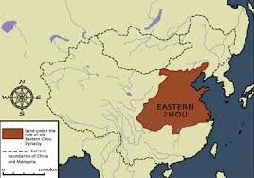
Eastern Zhou Dynasty
771 – 256 B.C.E.
In 771 B.C.E. migrating tribes forced the Zhou eastward
Beginning of the Spring and Autumn period
Continued erosion of royal power
Ruled over small city- states by 481 B.C.E.

Slide 14
Eastern Zhou Dynasty
In 481 B.C.E. the period of the Warring States began
By 476 B.C.E. escalating warfare reduced the number of independent states to around 40
The continued warfare created a political void and a few large states
Conquered by the Qin in 256 B.C.E.

Slide 15
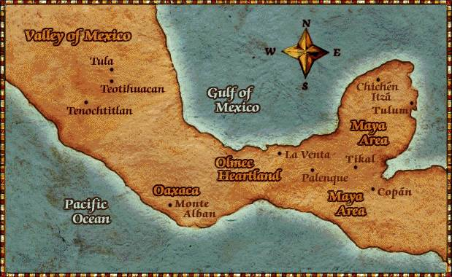
Mesoamerica Civilizations
Settled agriculture was widespread by 8000 B.C.E.
Establishment of cultural centers by 4000 B.C.E.
By 3500 B.C.E. cultivation of maize was widespread
By 1800 B.C.E. cities centered around temple complexes
City-states developed around 1500 B.C.E.

Slide 16
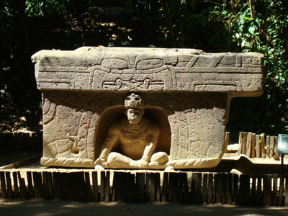
The Olmec
Began to dominate the central gulf coast of Mexico by 1500 B.C.E.
They were ruled by an elite priest class and developed cities with large public buildings and temples
They were ruled by an elite priest class and developed cities with large public buildings and temples
Expanding population allowed for the Olmec influence to spread

Slide 17
The Olmec
San Larenzo was the cultural center by 1200 B.C.E., but shifted to La Venta around 900 B.C.E
Developed temple complexes laid out in a grid pattern
Developed stone sculptures, ball games and works of art made from clay and jade
Developed a trade network that included Central America by 800 B.C.E.

Slide 18
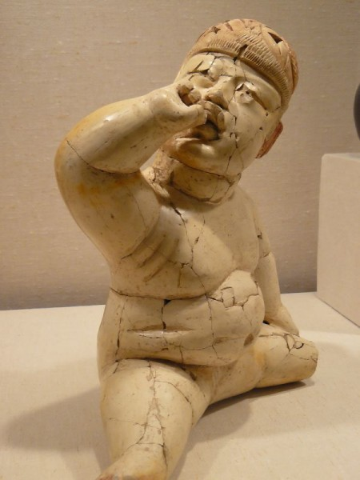
Decline of the Olmec
Culture relied mainly on maize, squash and sweet potatoes as food stuffs
Exploitation of land, warfare, droughts and natural disasters led to a breakdown of the culture around 400 B.C.E.
Laid the foundation for the future Mayan and Aztec Empires

